Slide 1
Quantum Gauss-Jordan Elimination for Code in Quantum
Kyungbae Jang, Hyunji Kim, and Hwajeong Seo

Slide 2
Contents
Our Contribution
Background & Related Work
Proposed Method
Performance & Evaluation
Conclusion & Future work

Slide 3
Our Contribution
We propose quantum Gauss-Jordan elimination
Implemented only with quantum gates
without Grover’s algorithm
Efficient quantum Gauss-Jordan elimination for binary matrix
Quantum arithmetic for quantum cryptanalysis of code-based ciphers

Slide 4





Code-based Cryptography
Applying coding theory to public key cryptosystems
Generates a pair of generation matrix and parity check matrix from the defined code
Used for Encryption and Decryption
Genrator Matrix $G$
$$mG+e=c$$
$$Code$$
Parity Check Matrix$H$
$$Hc=mGH+eH=eH$$

Slide 5
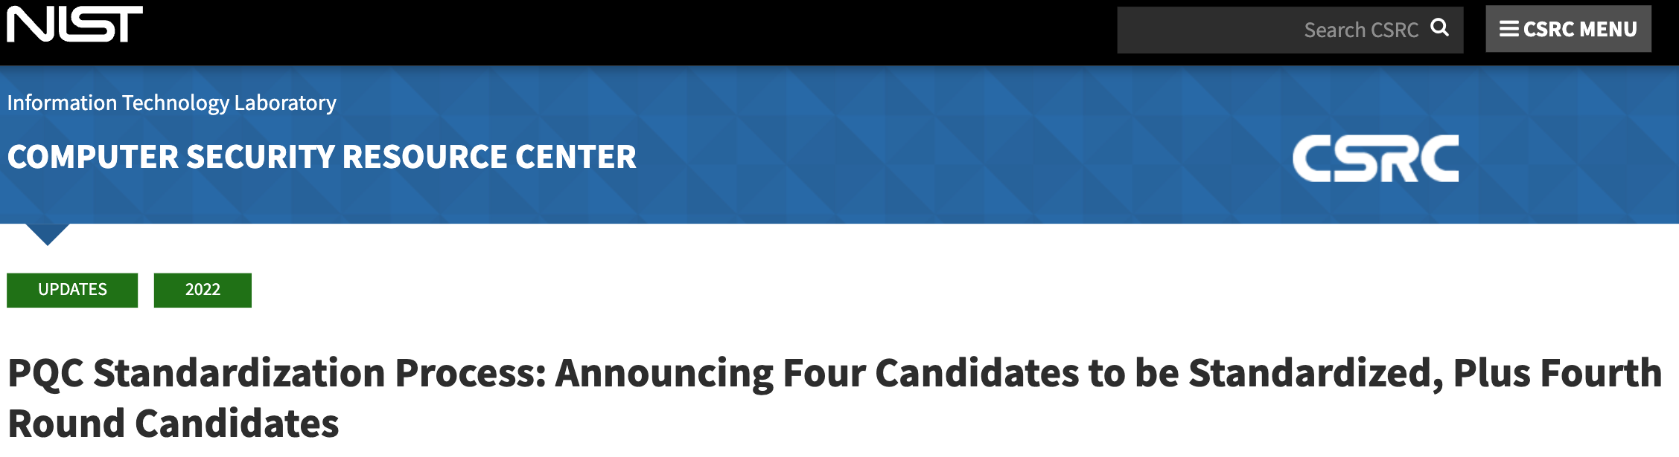
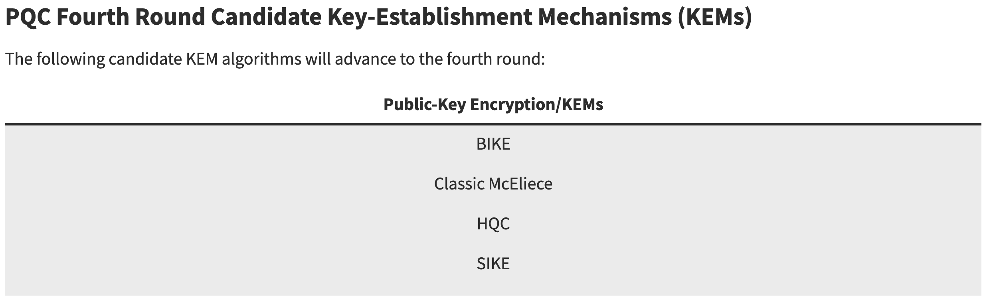
NIST Post-Quantum Cryptography Standardization
Post-quantum cryptography standardization contest in progress with NIST
In addition, round 4 is currently in progress
Code-based!!
Isogeny-based

Slide 6
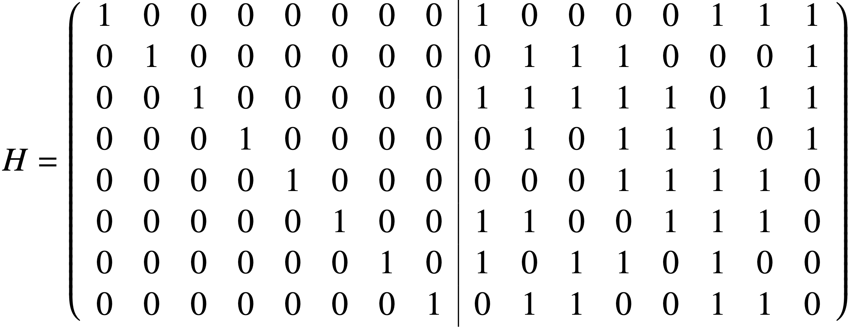

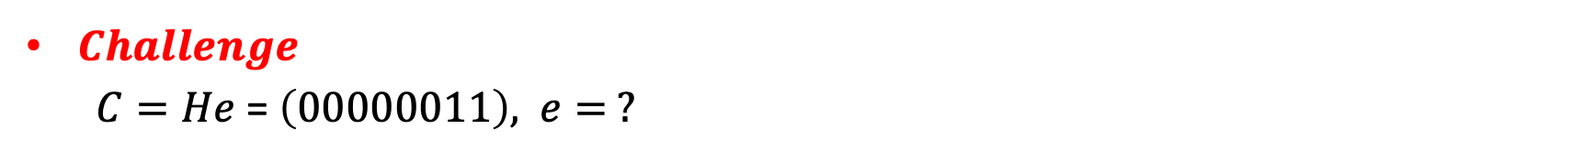
Classic McEliece
Classic McEliece is a Niederreiter system that uses a parity check matrix as its public key
A randomly generated vector with a weight condition $t$ is the secret value
$e$ = $( 0 0 0 0 0 0 1 1 0 0 0 0 0 0 0 0 )$→ $Secret$ (Weight $t=2$)
→ Public key (Parity check matrix)
$Challenge$
$C=He$ = $\left(00000011\right),$ $e= ?$

Slide 7




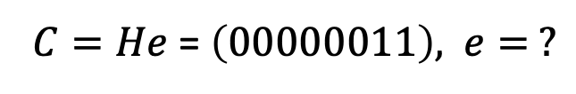
Information Set Decoding (ISD)
$Challenge$
$C=He$ = $\left(00000011\right),$ $e= ?$
※ ISD Summary
1. Randomly select as many columns as the
number of rows in the public key
2. The matrix constructed in this way is an
information set, if the information set is
invertible? Perform Gaussian Elimination
3. We can compute the inverse matrix of
the information set → Information set
4. Check $C ×$Information set ‘s weight
5. If we included all error locations in step 1, the
attack succeeded, in case , the attack failed
in case , the attack succeeded.
e = ( 0 0 0 0 0 0 1 1 0 0 0 0 0 0 0 0 )
$$−1$$
$$−1$$

Slide 8
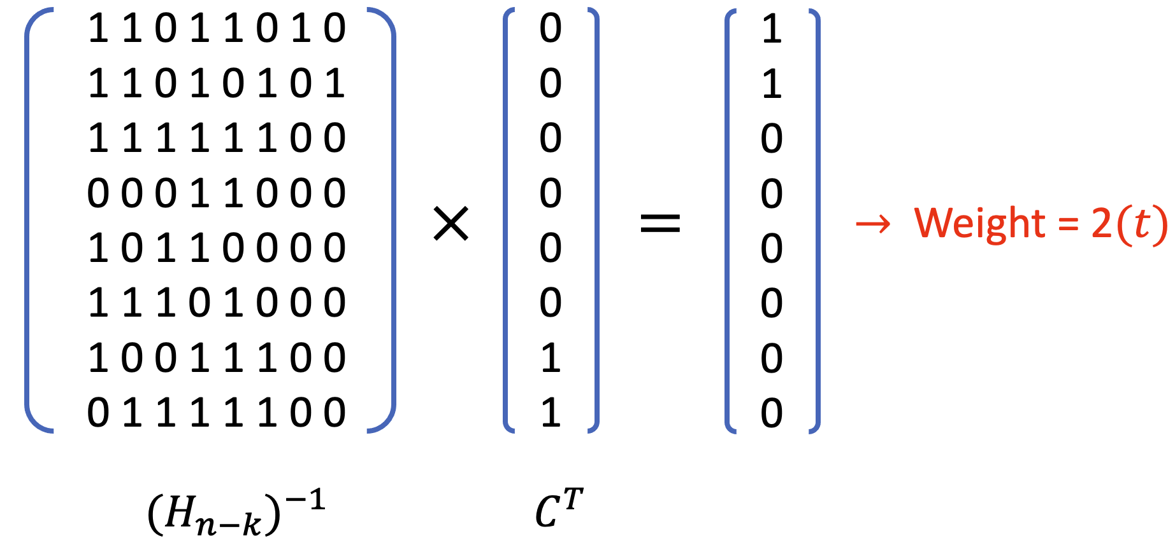
Information Set Decoding (ISD)
When the result vector of [Generated Inverse X Ciphertext] is Weight 𝑡=2,
Attack success → The result vector tells us the positions of the values ​​1.
Means that the 1st and 2nd of the column selected in step 1 are 1 → Recover 𝑆𝑒𝑐𝑟𝑒𝑡
e =

Slide 9
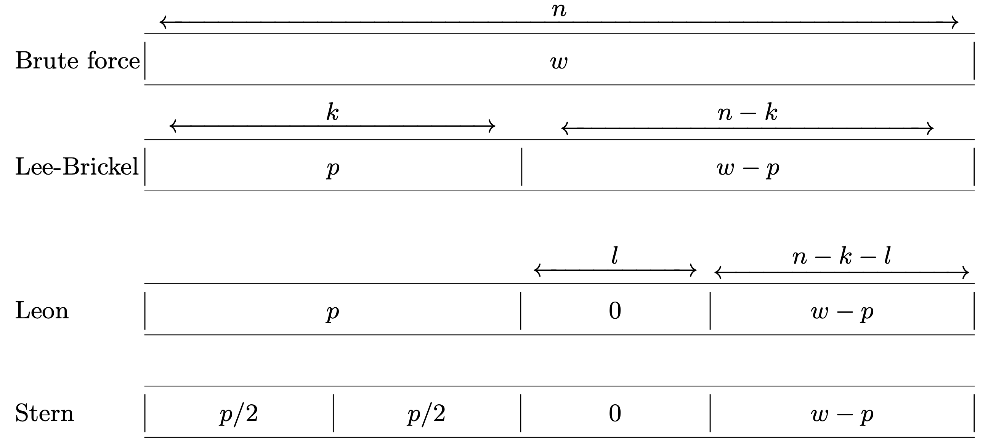
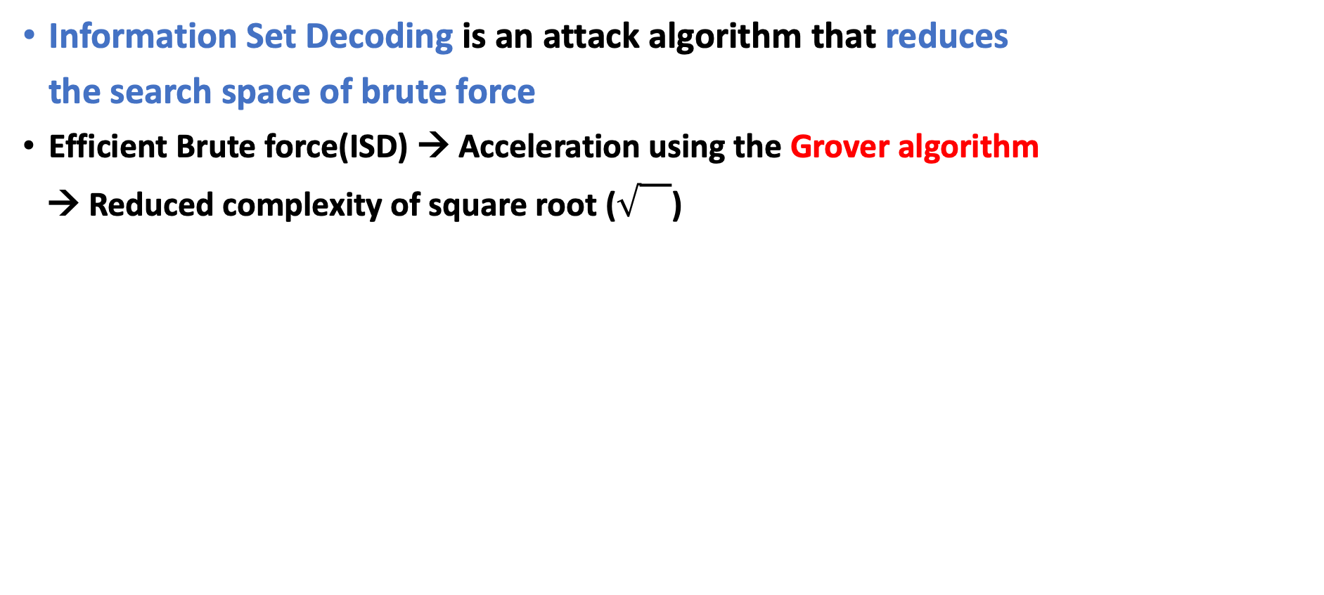



Information Set Decoding (ISD) in Quantum
Information Set Decoding is an attack algorithm that reduces
the search space of brute force
Efficient Brute force(ISD) → Acceleration using the Grover algorithm
→ Reduced complexity of square root ()
$$t$$
Prange’s ISD
$$0$$
$$t$$

Slide 10
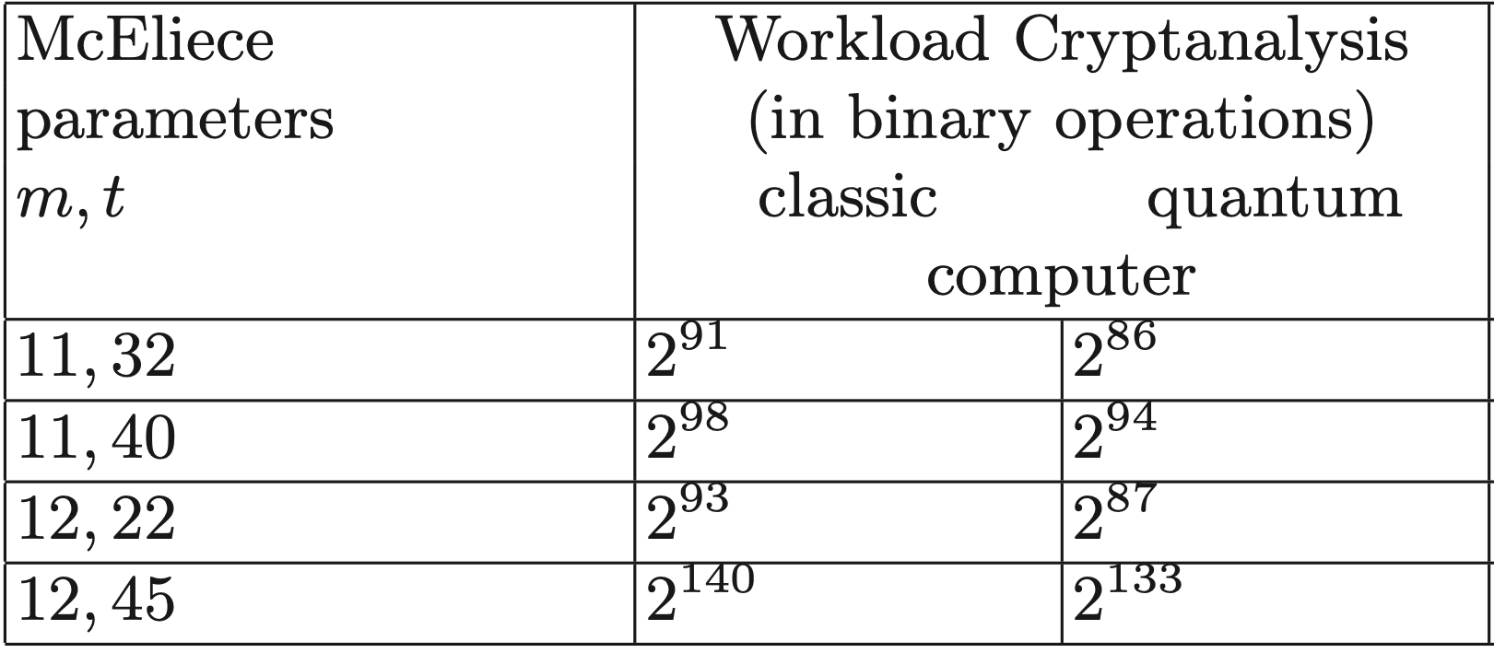
Quantum Information Set Decoding (QISD)
Overbeck–Sendrier’s analysis for QISD [1]
Grover's algorithm cannot reduce the complexity of information set decoding to the square root
[1] R. Overbeck, N. Sendrier, “Code-based cryptography”, 2009

Slide 11
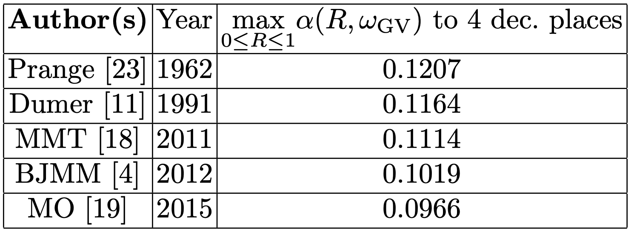
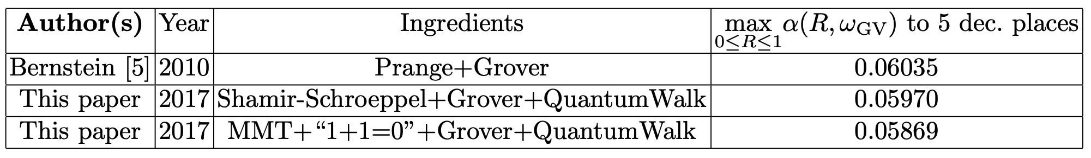
Quantum Information Set Decoding (QISD)
Bernstein’s QISD analysis in “Grover vs McEliece” paper[2]
Grover’s algorithm can reduce the complexity of Information Set Decoding to the square root
But, on a theoretical level
[3]
Reduced to the square root
[3]
[2] D. J. Bernstein, “Grover vs. McEliece”, PQCrypto, 2010
[3] G. Kachigar et al. “Quantum Information Set Decoding”, Cryptography and Security (cs.CR); Quantum Physics, 2017

Slide 12

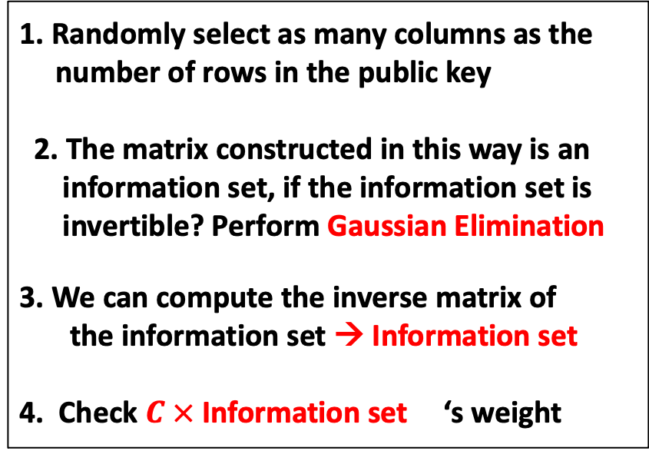

Quantum Information Set Decoding (QISD)
We implement and analyze quantum Gauss-Jordan elimination
1. Randomly select as many columns as the
number of rows in the public key
2. The matrix constructed in this way is an
information set, if the information set is
invertible? Perform Gaussian Elimination
3. We can compute the inverse matrix of
the information set → Information set
4. Check $C ×$Information set ‘s weight
Grover on ISD
1. Input Setting using butterfly network
2. Implement Quantum Gaussian Elimination
3. Weight check module for qubit vector
$$−1$$
$$−1$$
Quantum
Classical

Slide 13
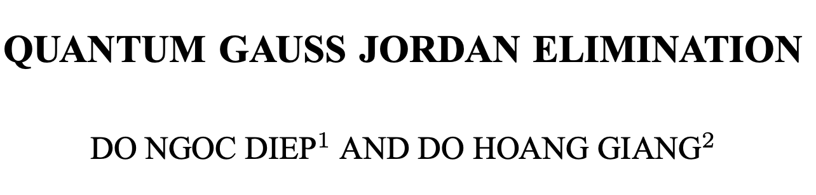
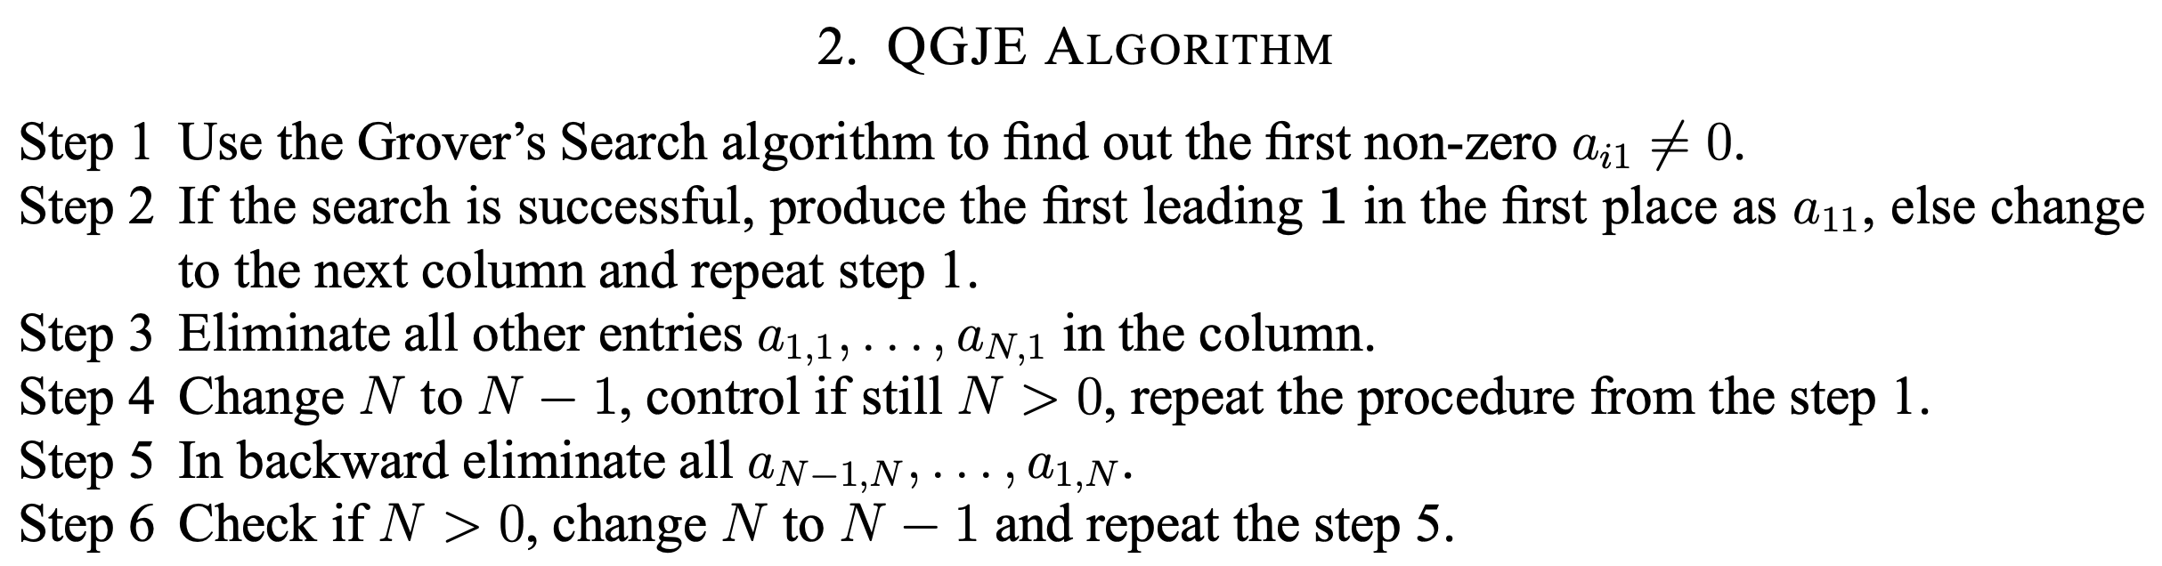
Quantum Gauss-Jordan Elimination
Previous work uses Grover’s algorithm to implement
quantum Gauss-Jordan elimination --> High quantum cost
.
.
.
D. N. Diep, D. H. Giang, “Quantum Gauss Jordan Elimination”, International Journal of Theoretical Physics, Vol. 56, 2017.

Slide 14
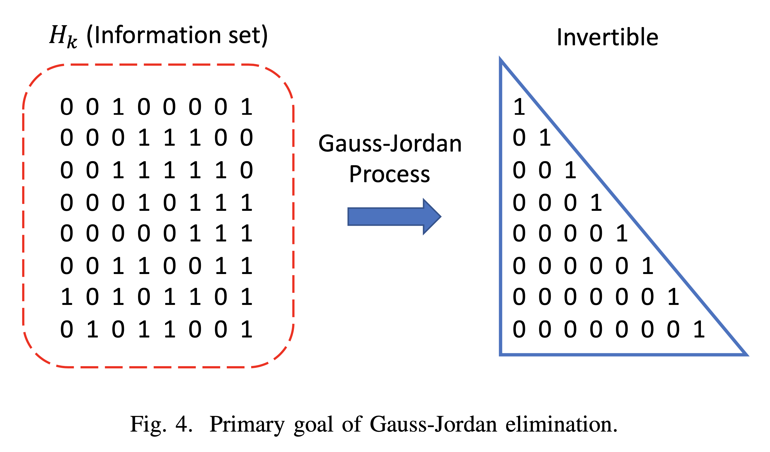
Quantum Gauss-Jordan Elimination
We need to implement the following as a quantum circuit.
Swaps between rows
Eliminations between rows

Slide 15
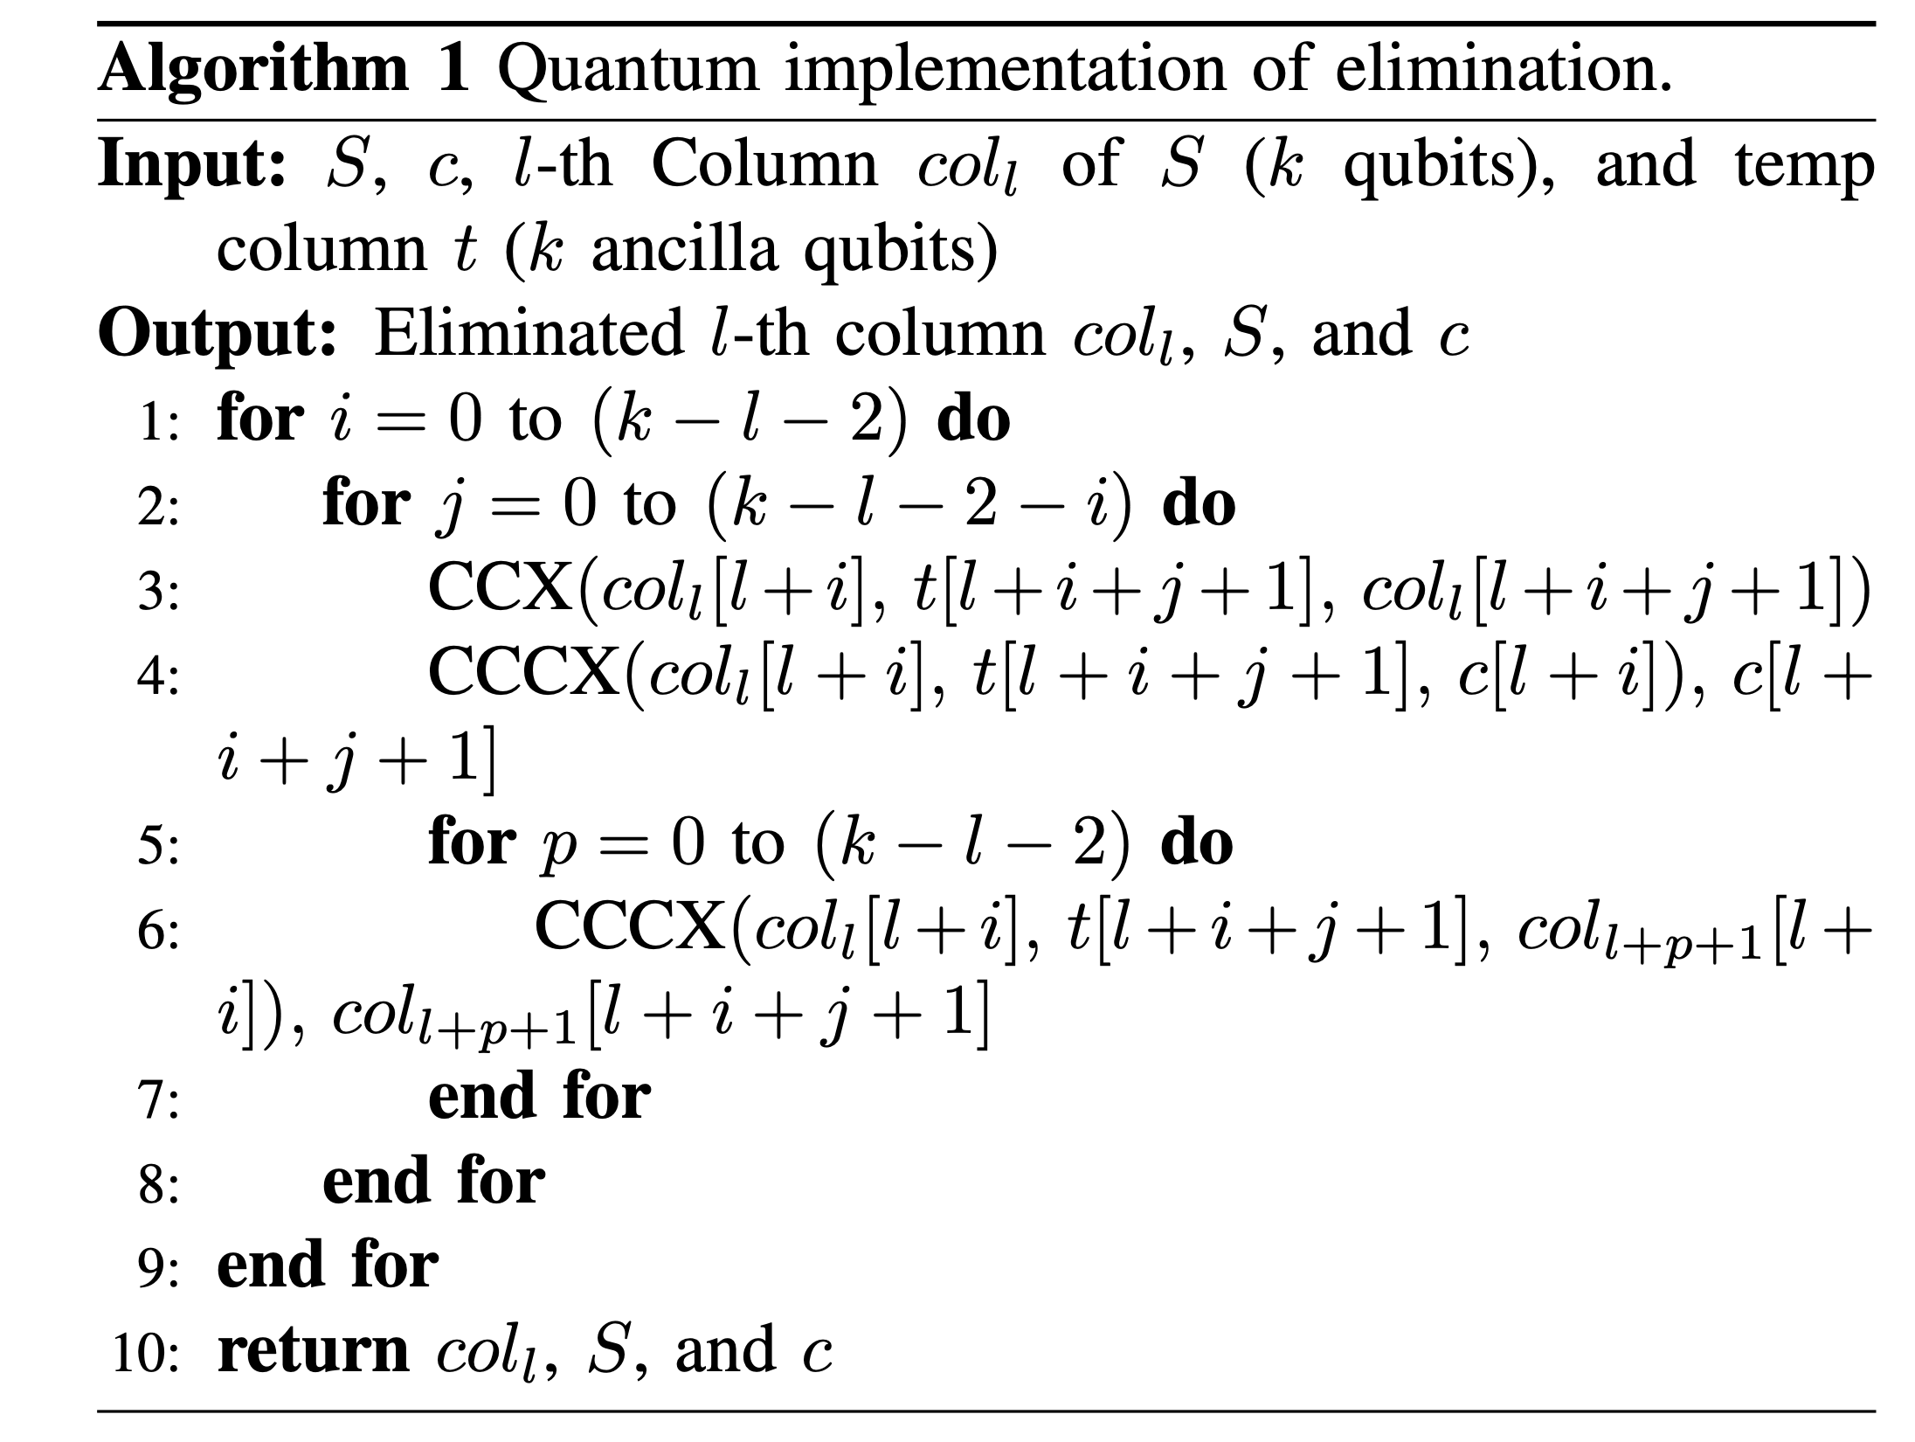
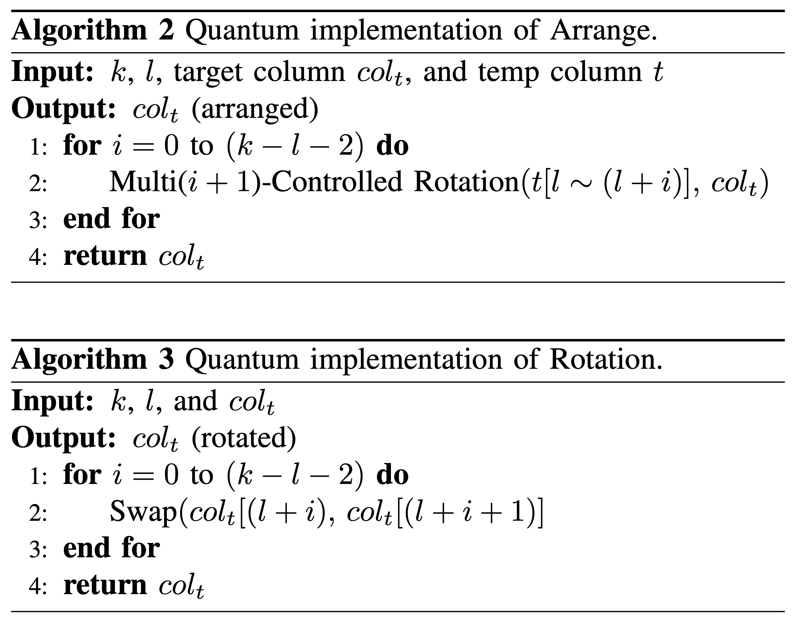
Quantum Gauss-Jordan Elimination
We implement quantum Gauss-Jordan elimination only with quantum gates
Elimination → implemented with CCX, CCCX gates
Swaps → Implemented with Multi-Controlled Swap gates
Implementation details can be found in the paper…

Slide 16
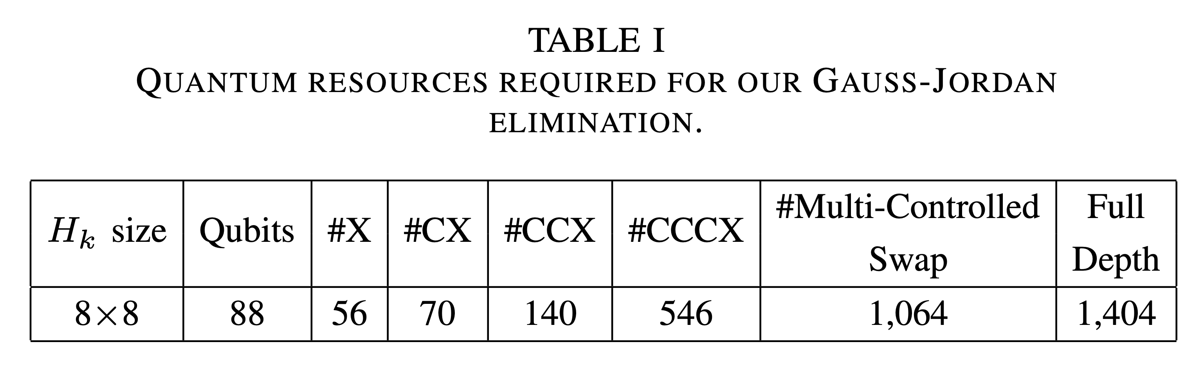
Quantum Gauss-Jordan Elimination
Estimation of quantum resources required for quantum Gaussian-Jordan elimination
In our implementation, the process of checking one row and one column
for a wide range of the target matrix is ​​repeated to perform quantum Gauss- Jordan
→ It is more efficient than using Grover's algorithm, but requires a lot of cost.

Slide 17
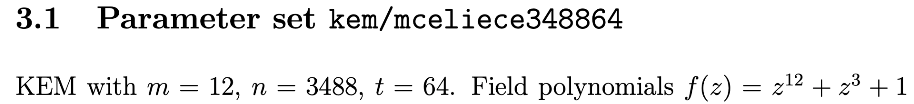
Analysis & Conclusion
Disadvantage of code-based ciphers
The key size is very large (very large memory capacity
Quantum attackers need very large memory (large qubits) and cost (gates and depth)to attack
mceliece348864 public key size → (768 X 3488) parity check matrix
In the case of QISD, setting the public key is an unconditional option
2,678,784 (2.6 million) qubits required for public key setting
Therefore, code-based cryptography is sufficiently resistant to quantum computers.
It is practically impossible to attack unless a new attack algorithm other than ISD comes out.

Slide 18
Thank you!

